Slide 1

DATA 1202 - Data Analysis Tools Analytics Final Project: Data Analytics using Machine Learning Professor: Sk. Md. Mizanur Rahman, Ph.D.
Group 4
Afshaan Shaikh - 100893464
Temitayo Ajayi - 100940989
Ibitomi Majolagbe - 100957240
Komal Verma – 100925046
Arti - 100942338

Slide 2

Problem Statement
How to leverage the power of machine learning to enhance cybersecurity measures by developing a helpful application capable of accurately classifying and identifying potential cyber threats in a cybersecurity field.

Slide 3
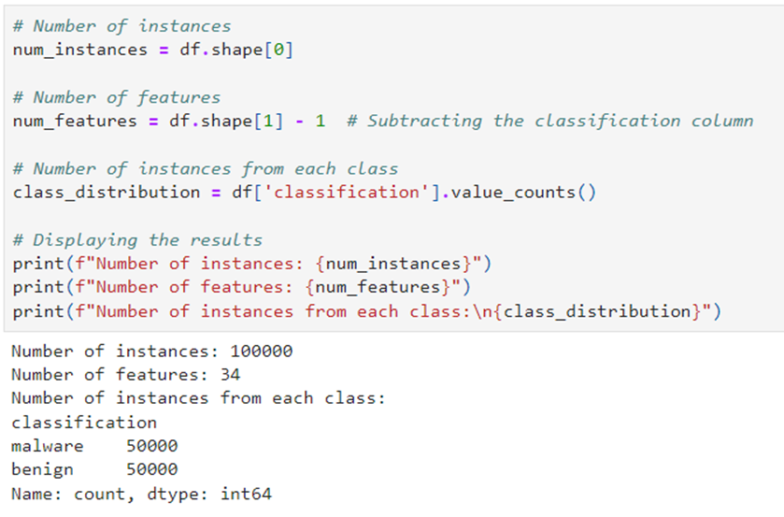
Procedure
The dataset was downloaded for further analysis, and it was read into pandas to extract this information:
The dataset contains 100,000 instances with 34 features. It is balanced, with 50,000 instances labeled as Malware and 50,000 as Benign.

Slide 4
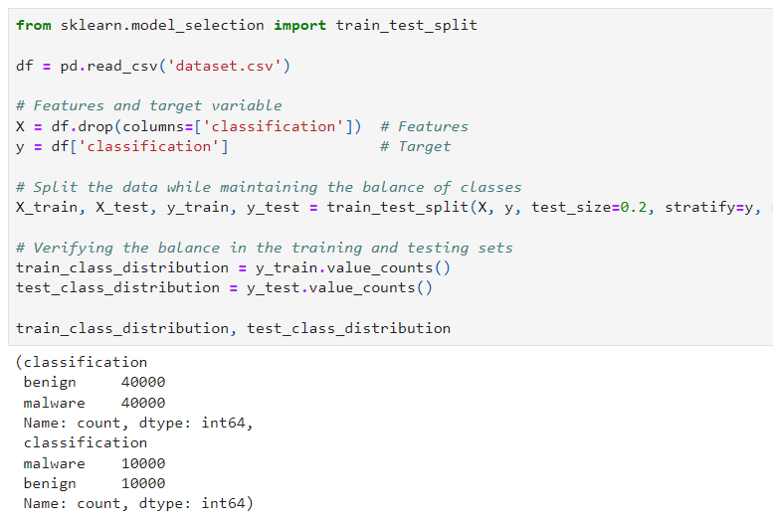
Testing and Training the data
The dataset was split into 80% for training and 20% for testing using a stratified split to ensure balanced representation of both Malware and Benign classes in the training and testing sets.

Slide 5

Exploratory Data Analysis (EDA)
The dataset was explored by displaying the first 5 rows, identifying column types, and summarizing statistics like mean, median, and standard deviation.
Missing values were checked, and various visualizations—histograms, box plots, pair plots, and a correlation heatmap—were created to understand feature distributions and relationships with the target variable.

Slide 6
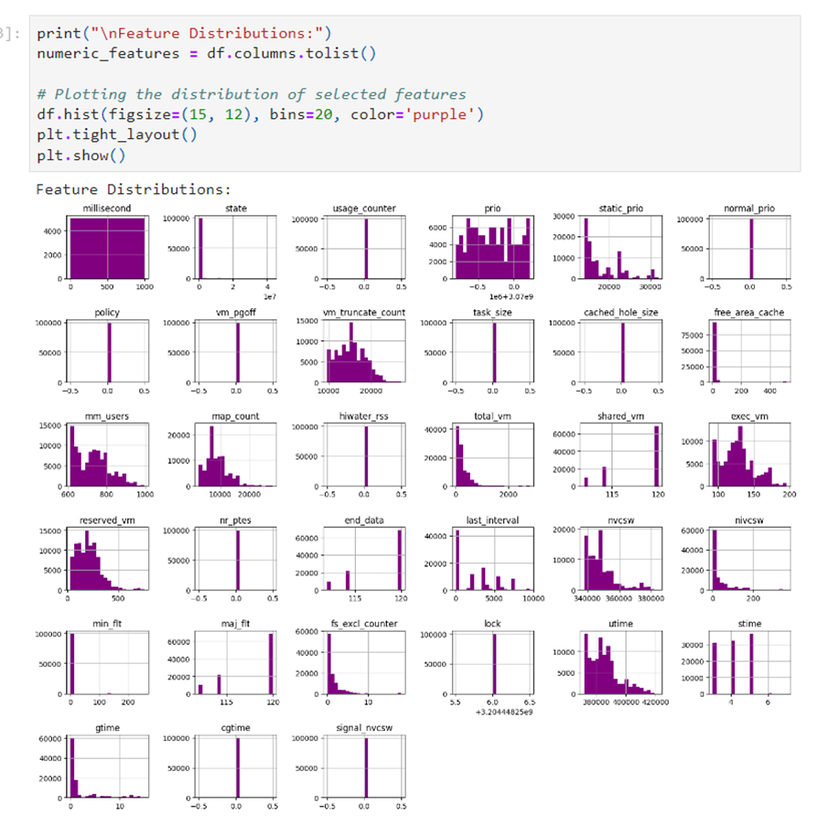
Key Insights from EDA
Feature distribution Histograms:
Several features, such as prio, total_vm, exec_vm, and nrcsw, are highly right-skewed, indicating that most values are concentrated at the lower end.
Features like state, task_size, and vm_truncate_count show bimodal or multimodal distributions, suggesting multiple distinct groups in the data.
Features like prio, total_vm, and cached_hole_size may have outliers, with most data points in a narrow range and a few lying far away.
Additionally, features like free_area_cache and mm_users have sparse distributions, with many data points having zero or very low values.

Slide 7
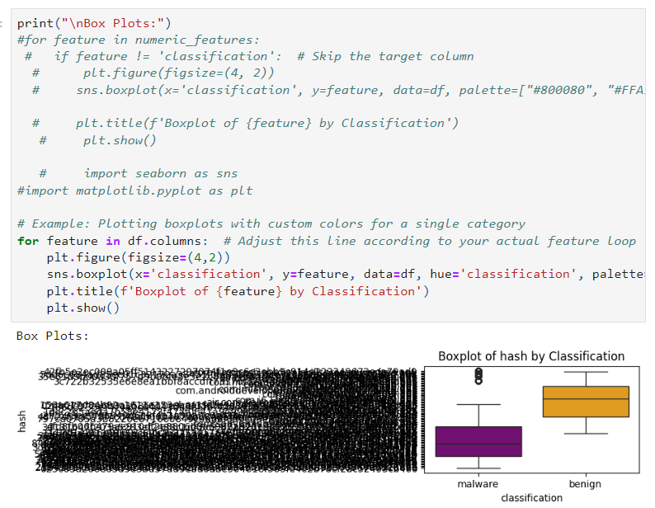
Box plots:
Outliers in the hash feature suggest some malware instances have distinct hash values, which may be crucial for analysis.
Benign instances have higher median hash values.
A wider interquartile range, indicates more variability in their hash values compared to malware.

Slide 8
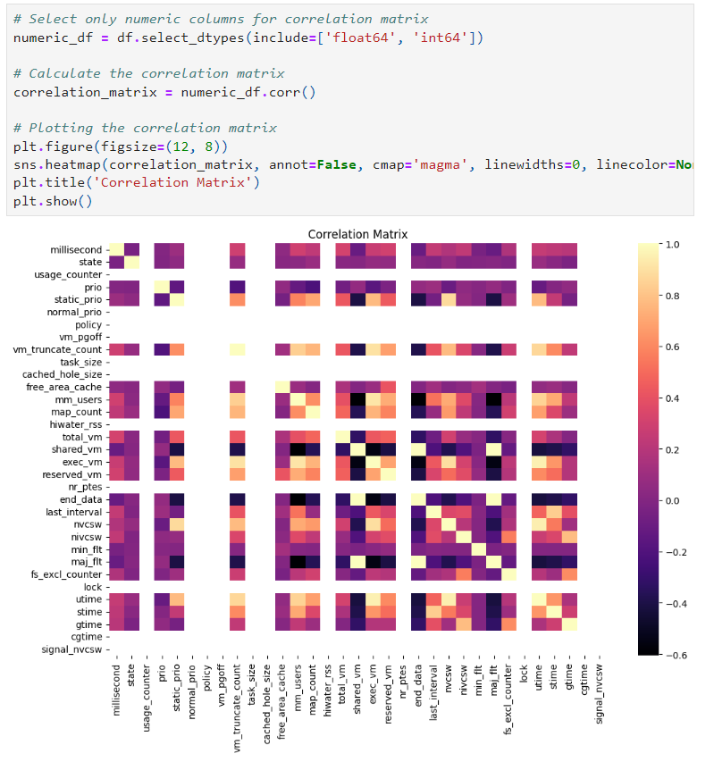
Correlation heatmap
Strong Correlations: There is a strong positive correlation between usage_counter and prio, as well as between cached_hole_size and shared_vm, indicating that these pairs of features tend to increase together.
Negative Correlations: There's a noticeable negative correlation between mm_users and total_vm, indicating that as the number of users increases, total virtual memory decreases. stimes and signal_nvcw also show a moderate negative correlation, where an increase in one feature tends to decrease the other.
Weak or No Correlations: Features like milliseconds, fs_excl_counter, and cgtime show weak or no correlation with others, suggesting independence or non-linear relationships.

Slide 9
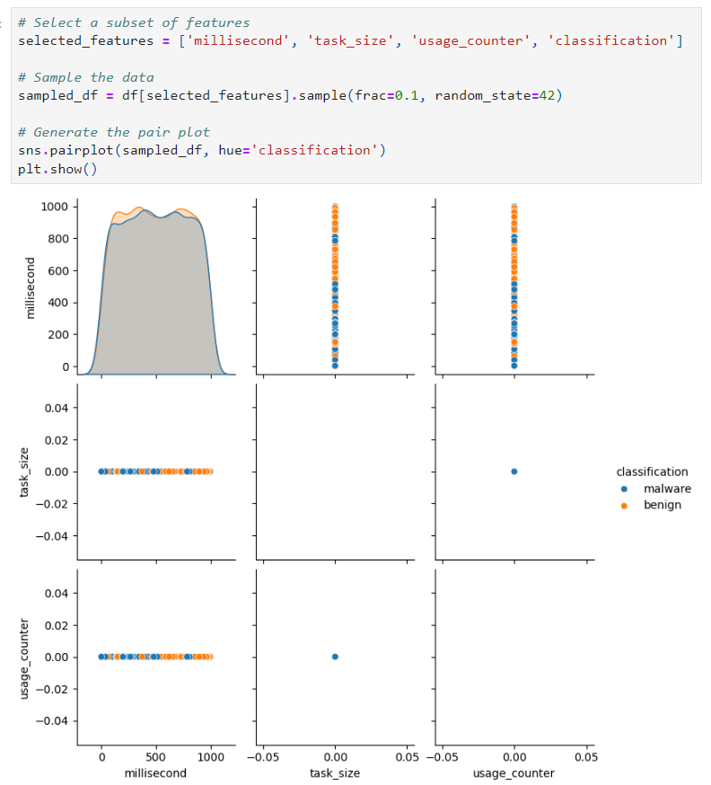
Pair Plot
The pair plot shows that millisecond, task_size, and usage_counter don't effectively separate Malware from Benign.
The data appears imbalanced or overlapping, and the density plot suggests a uniform distribution for millisecond.
Scatter plots reveal no clear patterns between these features and the classes.

Slide 10
Machine Learning Classifiers
The idea is to implement and compare different machine-learning classifiers for detecting Malware. Each classifier was trained on the training dataset. We used the following classifiers:
Classifier 1: Logistic Regression
Classifier 2: Decision Tree
Classifier 3: Support Vector Machine (SVM)
Classifier 4: Neural Network (NN)
Classifier 5: K-Nearest Neighbors (KNN)
To evaluate the performance of each trained classifier, we used metrics like accuracy, precision, recall, F1-score, and confusion matrix.

Slide 11
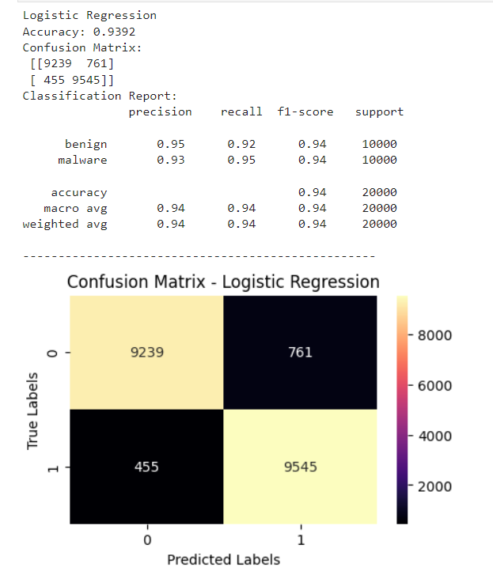
Classifier 1: Logistic Regression
The Logistic Regression model achieves a high accuracy of 93.92% with balanced precision, recall, and F1 scores for both classes.
However, it misclassifies 761 benign instances as Malware and 455 malware instances as benign, which could be critical depending on the application.

Slide 12
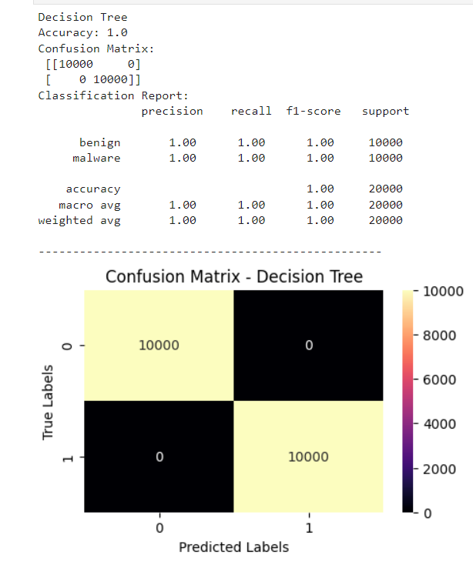
Classifier 2: Decision Tree
The Decision Tree model achieved 100% accuracy and perfect scores for both classes.
However, this raises concerns about overfitting and model complexity, as it may have memorized the training data rather than generalizing well.

Slide 13
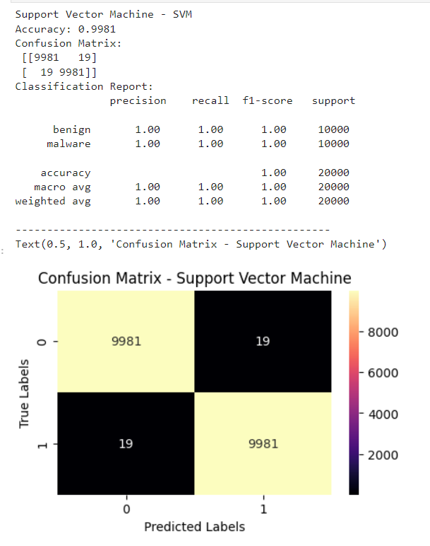
Classifier 3: Support Vector Machine (SVM)
The SVM model performs excellently with 99.81% accuracy and nearly perfect precision, recall, and F1 scores.
It misclassifies only 19 instances per class, suggesting it generalizes well, though further validation on a separate set could be useful.

Slide 14
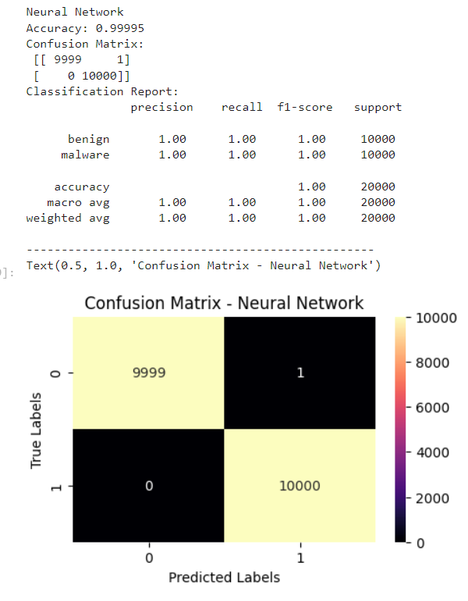
Classifier 4: Neural Network (NN)
The Neural Network model performs nearly perfectly with 99.995% accuracy and ideal precision, recall, and F1 scores.
It misclassified only one benign instance as Malware, with no misclassifications of Malware as benign.
The low error rate suggests high effectiveness, though the single misclassification may warrant further investigation.

Slide 15
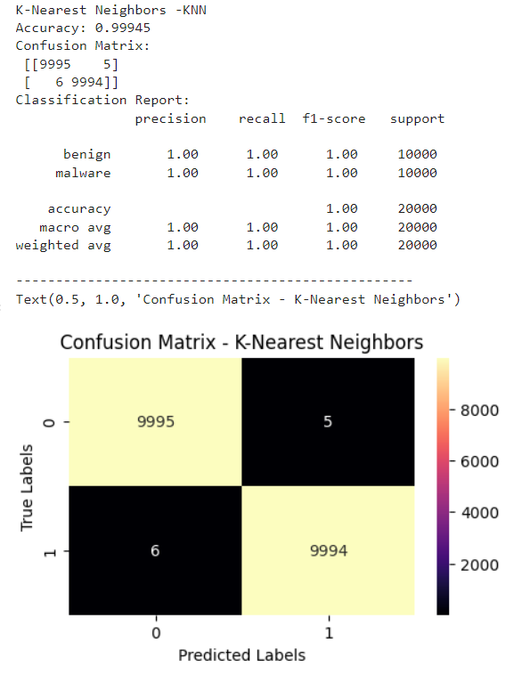
Classifier 5: K-Nearest Neighbors (KNN)
The KNN model achieves high accuracy (99.945%) with only 11 misclassifications out of 20,000 instances.
It incorrectly classifies 5 benign instances as Malware and 6 malware instances as benign.
Further validation on a separate set could be beneficial due to KNN's sensitivity to data distribution and the choice of "k."

Slide 16
Conclusion
We recommend the Neural Network for enhancing cybersecurity due to several key advantages:
High Accuracy: The Neural Network achieves nearly perfect accuracy, with only 1 misclassified instance. This high level of precision is crucial for cybersecurity, where missing a threat can have serious consequences.
Complex Relationship Handling: Neural Networks excel at capturing complex, non-linear relationships in data. This capability is essential in cybersecurity, where threats can be highly variable and evolve rapidly.
Scalability: Neural Networks can scale and adapt to large and diverse datasets. In cybersecurity, where new types of threats continuously emerge, a Neural Network can be fine-tuned to accommodate and identify these new threats effectively.
Overall, the Neural Network's accuracy, ability to manage complex data relationships, and scalability make it a powerful tool for accurately identifying and responding to potential cyber threats.

Slide 17
Thank You !!

